Slide 1
HILL CLIMBING ALGORITHM

Slide 2
Hill Climbing
Hill climbing algorithm is a local search algorithm which continuously moves in the direction of best solution to the problem.
Hill climbing algorithm is a technique which is used for optimizing the mathematical problems.
It is also called greedy local search as it only looks to its good immediate neighbor state and not beyond that.
One of the widely discussed examples of Hill climbing algorithm is Traveling-salesman Problem

Slide 3
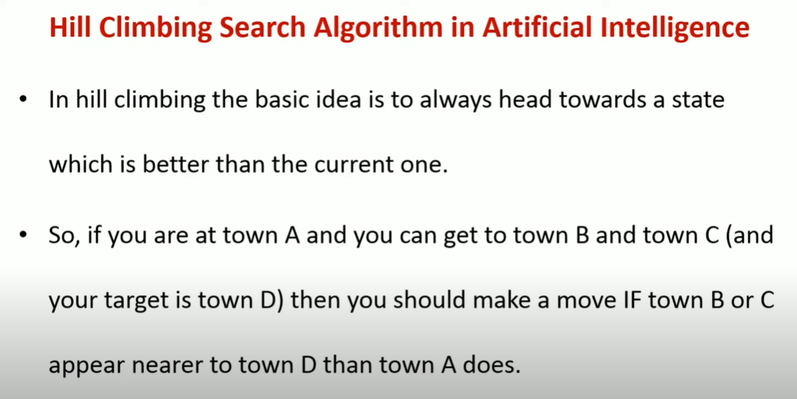
Hill Climbing

Slide 4
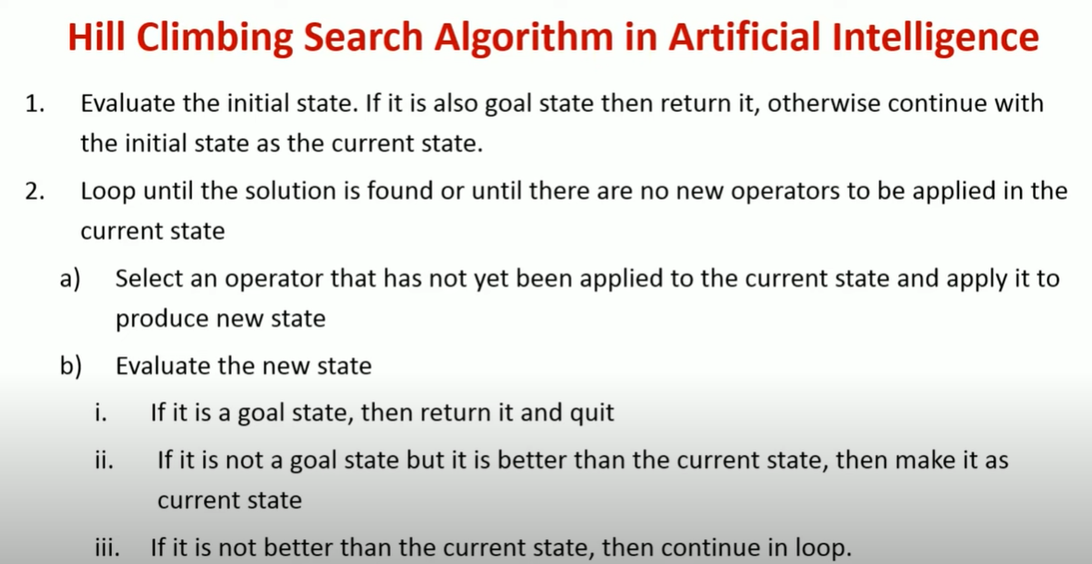
Hill Climbing

Slide 5
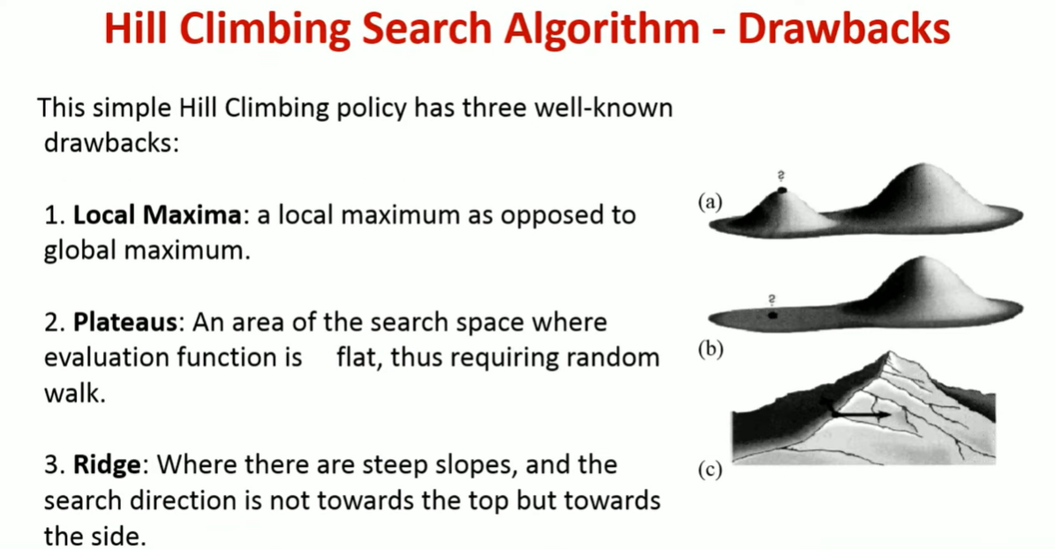

Slide 6
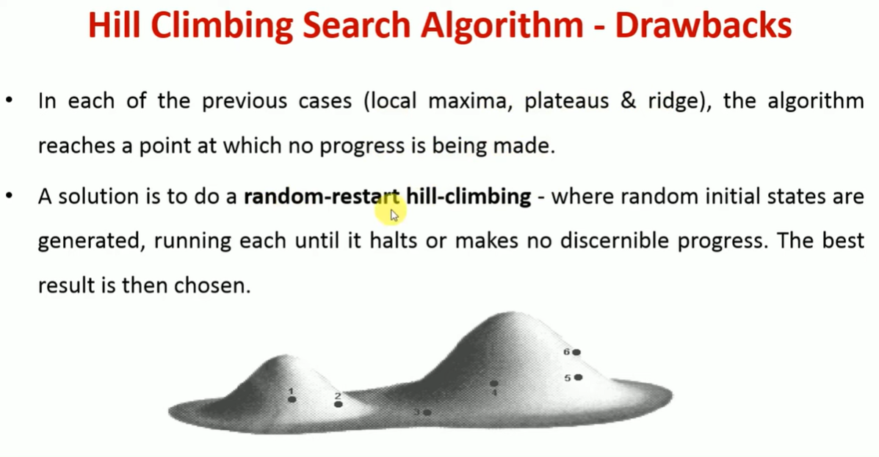

Slide 7
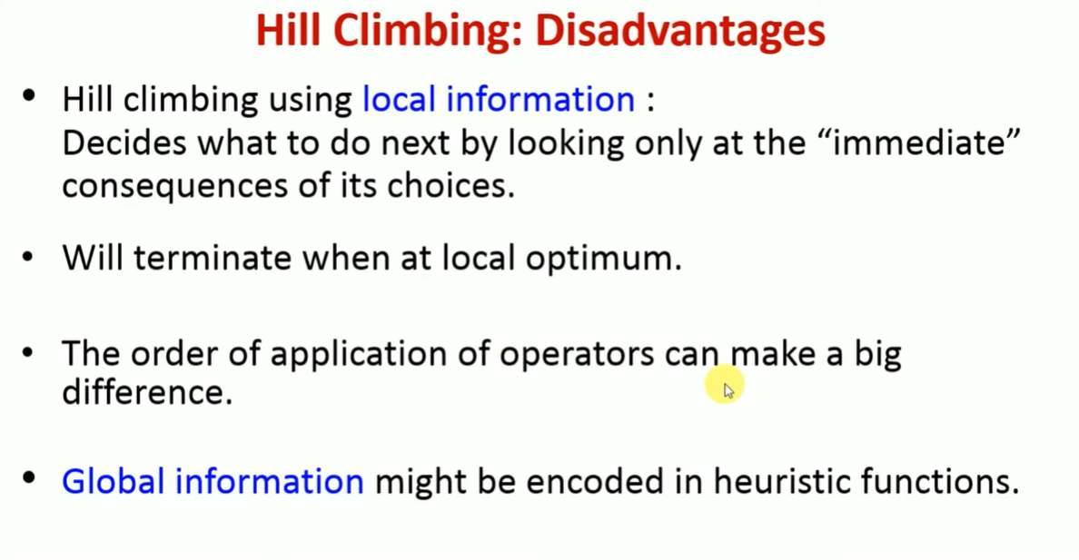

Slide 8
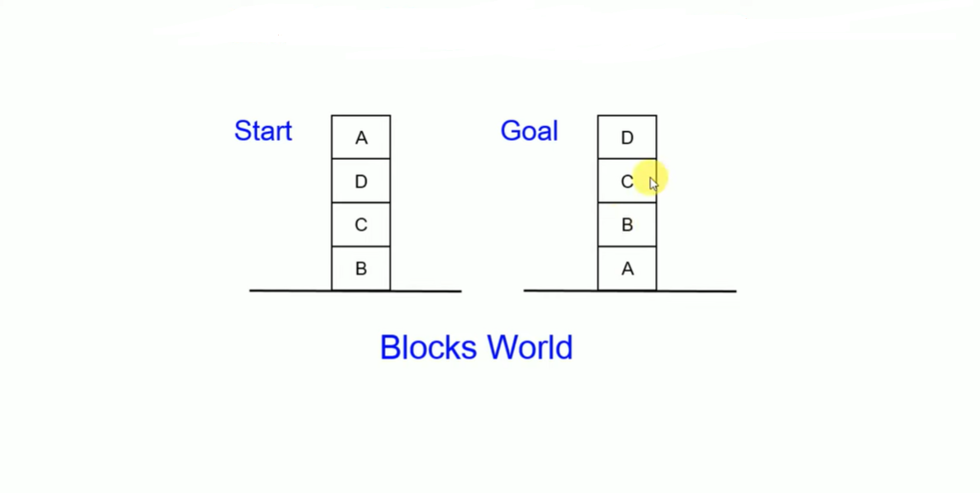
Solved Example

Slide 9
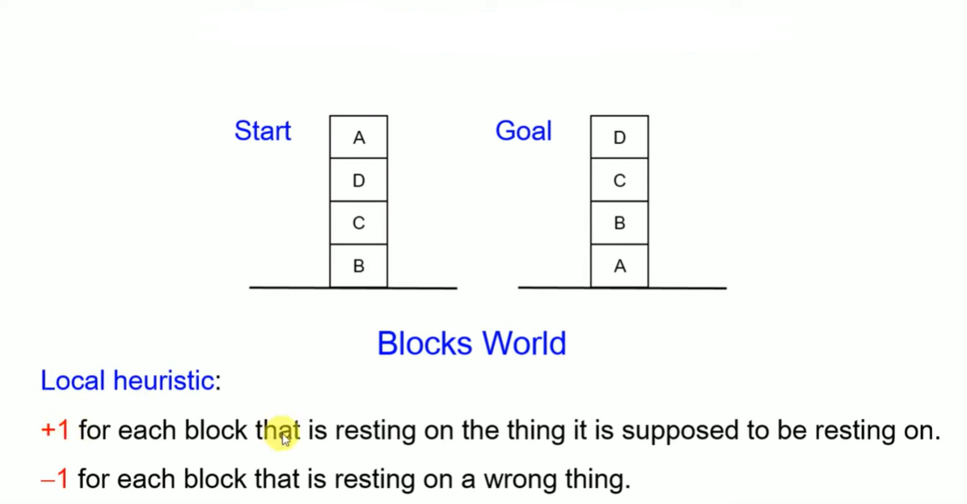
Solved Example

Slide 10
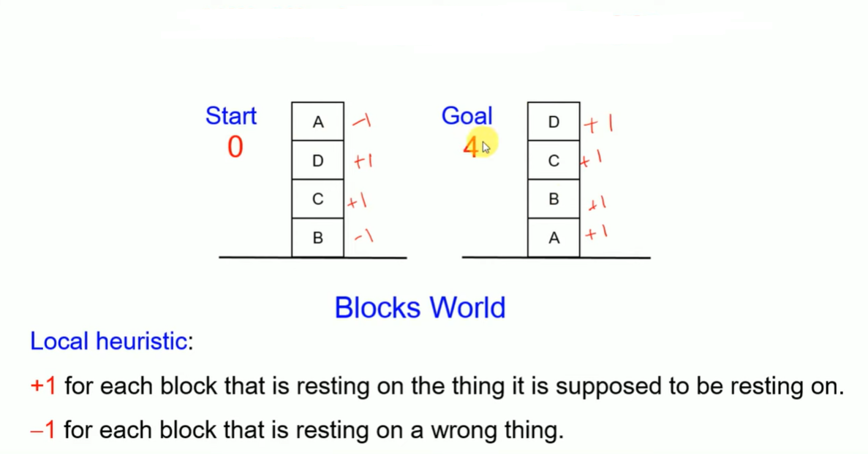
Solved Example

Slide 11
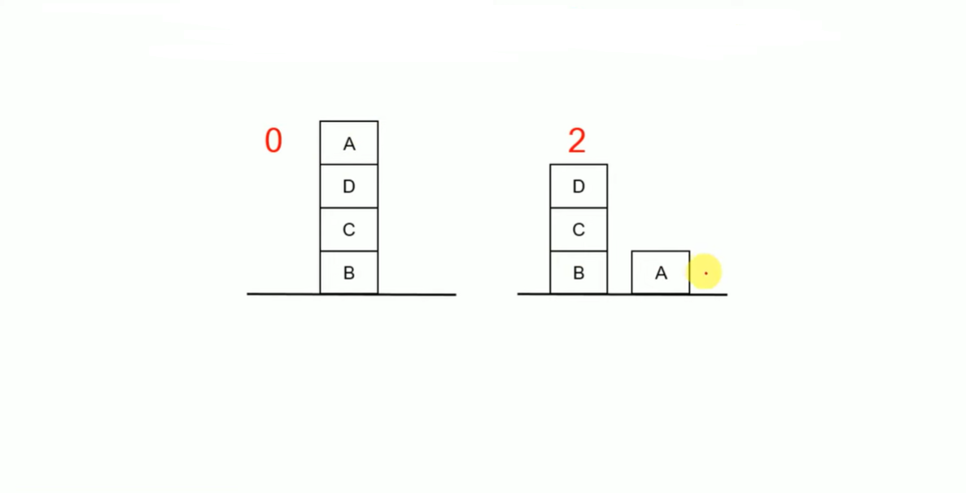
Solved Example

Slide 12
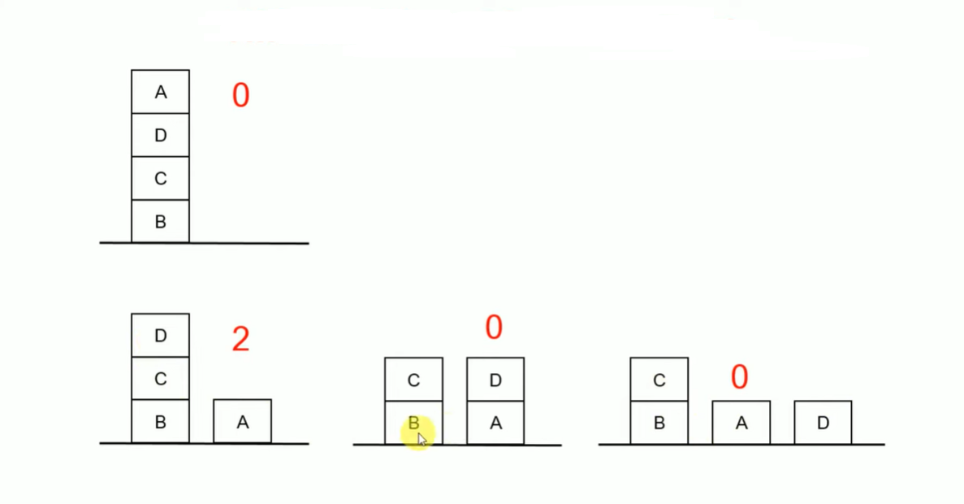
Solved Example

Slide 13
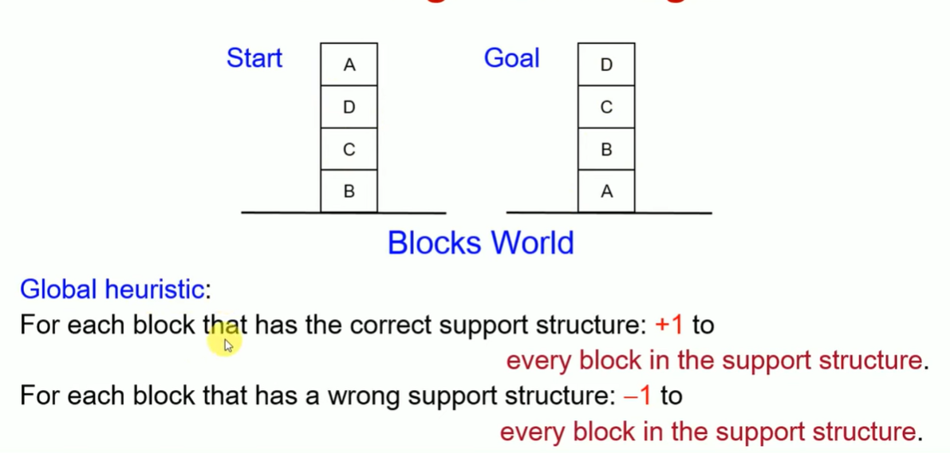
Solved Example

Slide 14
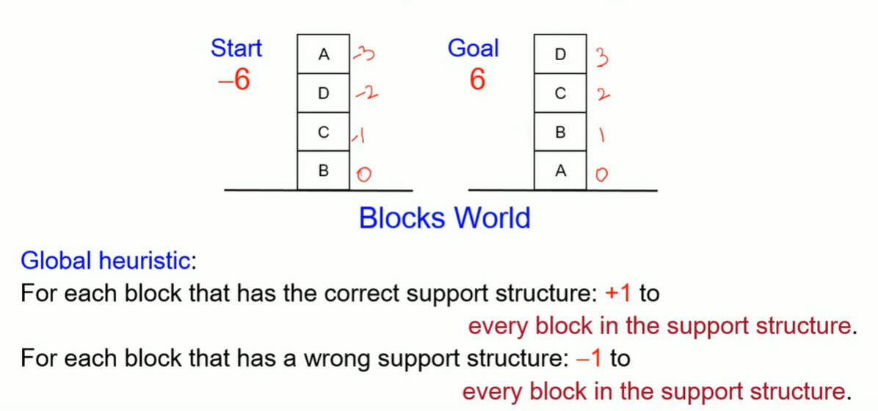
Solved Example

Slide 15
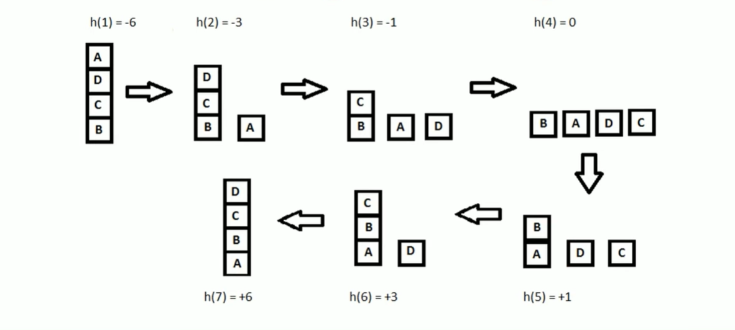
Solved Example

